Slide 1

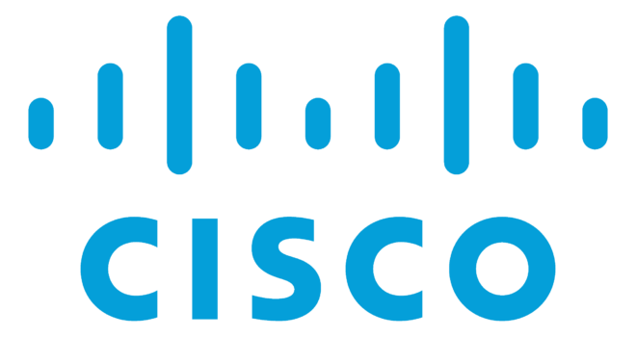
Cisco Packet Tracer
An Essential Virtual Network Simulation and Learning Platform

Slide 2
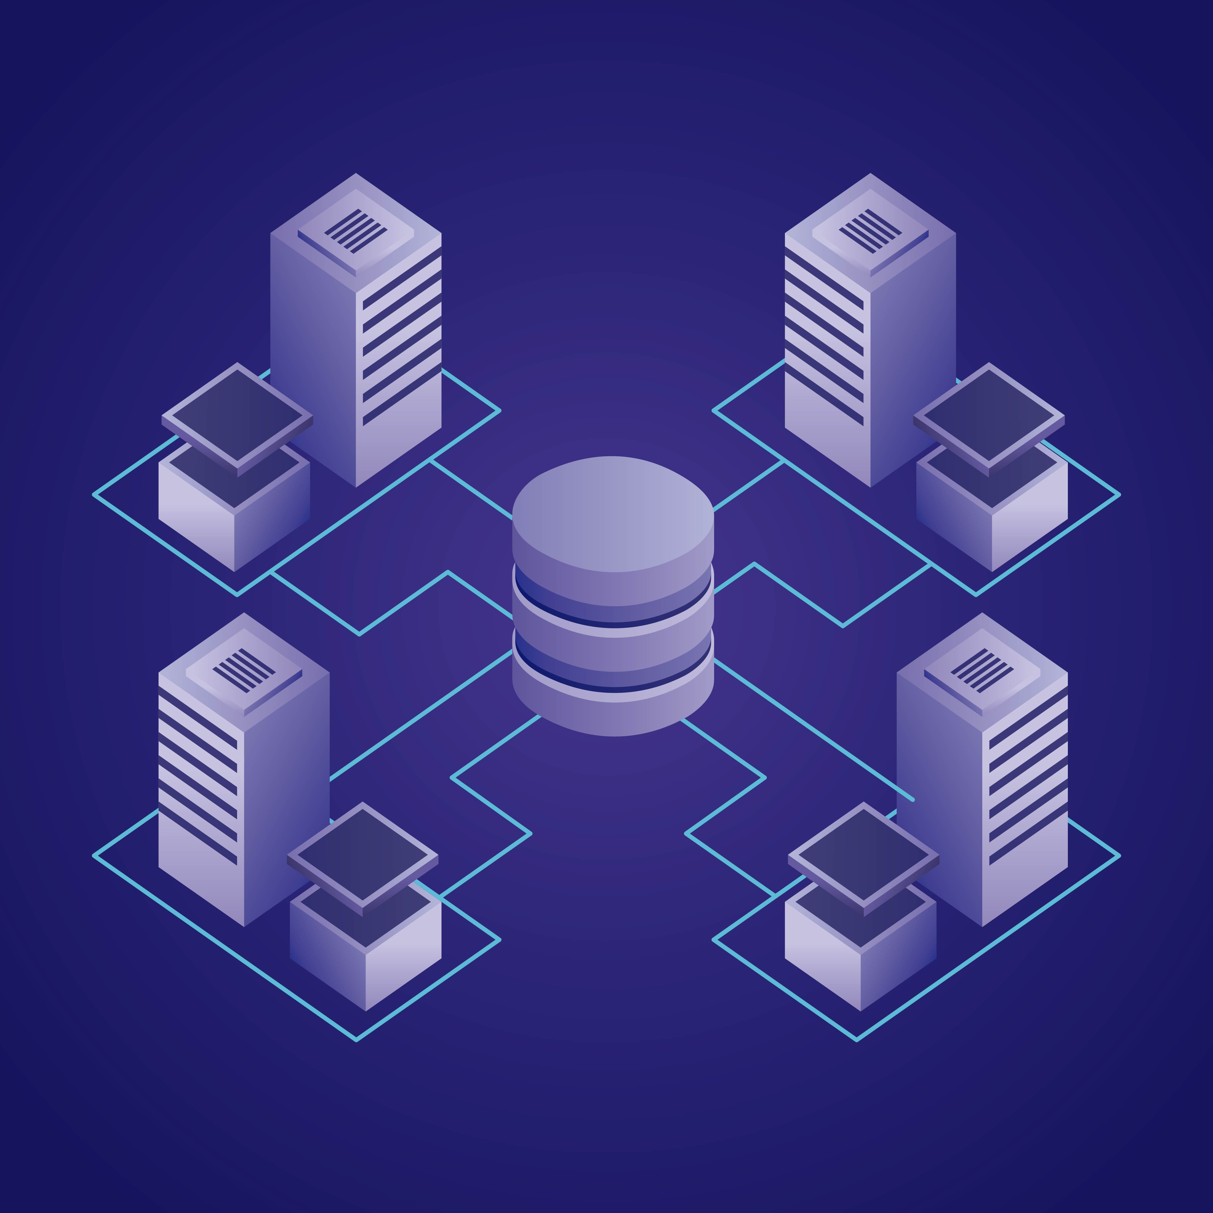
What is Cisco Packet
Tracer
Cisco Packet Tracer is a Application Software Developed to Design, Configure, Simulate and troubleshoot networks in a virtual environment.

Slide 3
Core Features & History
Understanding how virtual simulation accelerates IT education and development

Slide 4







Main Platform Capabilities
Network Design
Multi-Mode Testing
IoT & Automation
Drag and drop devices into the active canvas. Construct custom structural layouts and test connections in a safe sandboxed zone.
Seamlessly toggle between Real-Time performance and detailed Simulation Mode to monitor frame structures and headers.
Support for sensors, actuators, and code components allowing users to program real-world smart scenarios via Python.

Slide 5
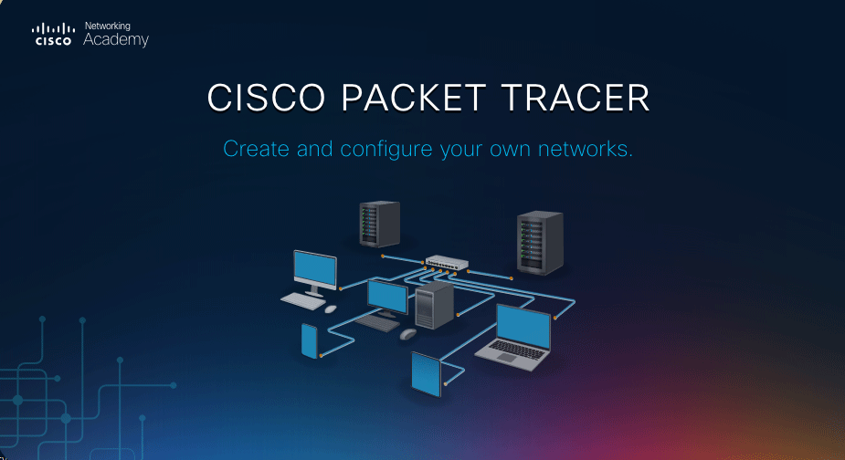
History and Evolution
Designed for Scale
Created by Cisco Systems as an anchor resource for the Networking Academy program.
Developed to eliminate the steep expense barriers of physical routers and switch laboratories for global educational programs.
Today, it supports wireless integrations, virtual cybersecurity configurations, API setups, and automation tools.

Slide 6

Some Main Features :
Network Simulation and Visualization.
Configuration of Routers, Switches, Servers and end devices.
Real-time Simulation modes
Support of internet of thins (IOT) devices
Troubleshooting and packet analysis tools

Slide 7



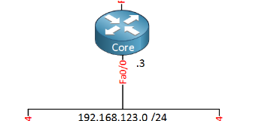
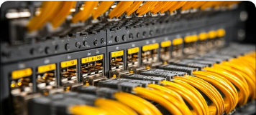
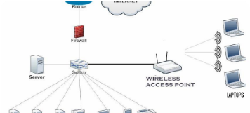
Essential Network Components
End Devices
Desktop PCs, laptops, network servers, IP phones, and tablets that initiate or consume actual data packets.
Network Devices Enterprise routers, managed switches, hubs, smart firewalls, and access points that guide and inspect traffic.
Connections & Media
Copper Straight-Through, Cross-Over, Fiber Optic, and Serial interfaces matching actual cabling requirements.

Slide 8


Device Configuration Methods
Graphical User Interface (GUI)
Command Line Interface (CLI)
Intuitive window menus built for fast configurations and newcomers to systems administration.
A replica of the Cisco IOS console environment used in actual data centers.
Users can adjust general server services (DHCP, HTTP, DNS), insert components visually, and view statistics immediately without writing terminal scripts.
Teaches industry-standard operations like setting interfaces, assigning VLAN tag headers, dynamic routing, and checking protocols via diagnostic commands.

Slide 9
Routing & Segmentation
Build Structural Networks
100%
Static & Dynamic Routing: Manually establish routes or deploy adaptive dynamic protocols like OSPF, RIP, and EIGRP to calculate the best data pathways across multiple branches.
INTERACTIVE PRACTICE
VLAN Separation: Segment department lines like Finance, Administration, and HR into isolated Virtual Local Area Networks to optimize data protection and secure bandwidth use.

Slide 10
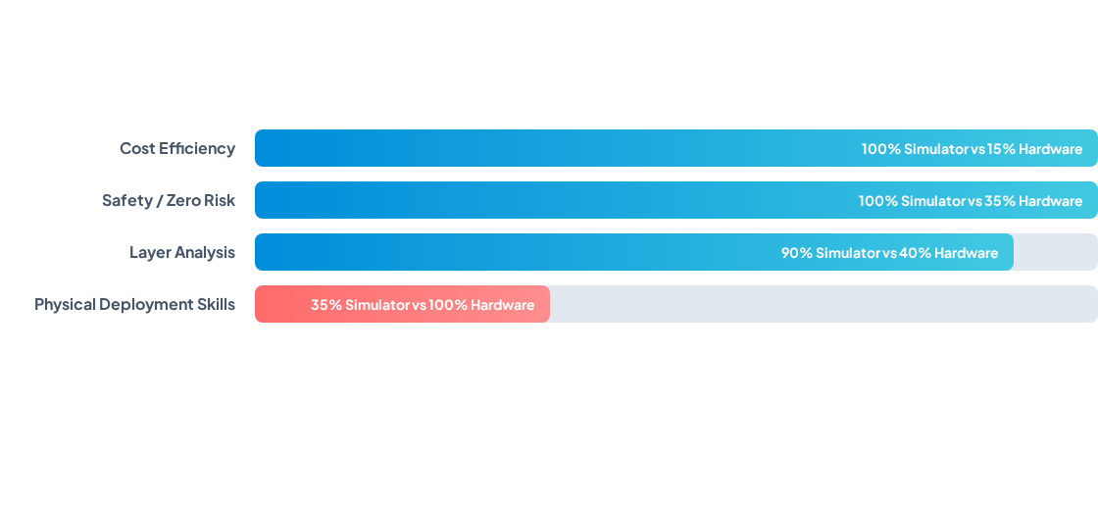
Simulator vs Hardware
Though simulators offer unparalleled safety and cost savings, they are best paired with real laboratory hardware to gain tangible cabling skills.

Slide 11
Simple Network Setup
Step 2
Connect both PC terminals to empty Fast Ethernet ports using Straight-Through cables.
Step 4
Open CMD on PC0 and ping 192.168.1.2 to verify successful virtual connectivity.
Step 1
Step 3
Drag PC0, PC1, and Switch0 onto the workspace from the library panel.
Assign IPs: 192.168.1.1 on PC0 and 192.168.1.2 on PC1 with standard subnet masks.

Slide 12
Advantages of Cisco Packet Tracer
Zero Hardware cost.
Building a physical lab with routers, switches, access points, and firewalls is incredibly expensive. Packet Tracer provides a massive inventory of Cisco hardware virtually for free.

Slide 13

For Example : If need to Test and Configure DHCP Server
With Real Devices
With Packet Tracer
Devices Needed.
Routers 1 $40 - $120
Switch 1 $30 - $80
PCs 2/4 $70 - $150
Ethernet Cables $10 - $20
Total Cost : $150 - $ 370
( LKR 45,000 – 150,000)

Slide 14
Advantages of Cisco Packet Tracer
Risk-Free Environment
You can crash a network, misconfigure a routing protocol, or cause a switching loop without the fear of breaking expensive physical equipment or disrupting a live production network.

Slide 15
For Example :
You can purposely build a "Switching Loop" (connecting multiple cables between two switches without Spanning Tree Protocol enabled). You will watch the virtual link lights turn blinking red as a broadcast storm crashes the topology. To fix it, you simply delete a cable or type a single command, restoring everything in seconds with zero financial damage.

Slide 16
Cisco Packet Tracer is Important
Advanced Visualization Tools
Simulation Mode: Unlike real hardware where data moves invisibly through cables, Packet Tracer allows you to freeze time and watch packets (PDUs) travel step-by-step across the network.
Protocol Analysis: You can click on a packet at any point in its journey to inspect its headers (Layers 1 through 7), which is invaluable for understanding how protocols like TCP, IP, DNS, and ARP actually work.

Slide 17
Scenario : You are trying to figure out why a computer cannot access a website
In Real Life: You just get a "Timed Out" error on your screen, and you have to guess where it failed.
In Packet Tracer: You switch to Simulation Mode and click "Go." You will see an envelope icon leave the PC, travel to the switch, move to the router, and suddenly stop at a Firewall. You can click on that specific envelope, and Packet Tracer will show you a note: "Layer 3: The packet matches the criteria of Access Control List 101 and is dropped." It visually points out the exact point of failure.

Slide 18
Real-World Applications
"Packet Tracer is the primary gateway between technical theory and active enterprise deployments, letting us build and crash designs safely."
"
"
— Networking Academy Administrator

Slide 19
Conclusion
Cisco Packet Tracer is a powerful and widely used network simulation tool developed by Cisco.
It provides a virtual environment for designing, configuring, testing, and troubleshooting computer networks.
The software includes a wide range of networking devices such as routers, switches, servers, wireless devices, and end-user devices.
Users can practice networking concepts without the need for expensive physical equipment.
Features such as Real-Time Mode and Simulation Mode help users understand how data travels through a network.

Slide 20
Conclusion
Cisco Packet Tracer supports important networking technologies including IP addressing, DHCP, VLANs, routing, switching, wireless networking, and network security.
It is an excellent learning platform for students, educators, and networking professionals.
The software helps bridge the gap between theoretical knowledge and practical implementation.
It allows users to develop troubleshooting skills and gain hands-on experience in a safe environment.
Cisco Packet Tracer is commonly used for networking education, laboratory exercises, project development, and certification preparation such as CCNA.

Slide 21
Final Statement
Cisco Packet Tracer plays a vital role in networking education by providing an interactive, practical, and affordable platform for learning modern networking technologies.

Slide 22

As future IT professionals, learning Cisco Packet Tracer can help us develop practical networking skills and prepare for real-world networking environments.

Slide 23
Thank You !

